Slide 1
Query Optimization
F21DF Database and Information Systems
Alasdair J G Gray A.J.G.Gray@hw.ac.uk
Notes:
Socrative quiz on lecture room machine

Slide 2

Materials released under CC-BY License
You are free to:
Share — copy and redistribute the material in any medium or format
Adapt — remix, transform, and build upon the material for any purpose, even commercially.
The licensor cannot revoke these freedoms as long as you follow the license terms.
Under the following terms:
Attribution — You must give appropriate credit, provide a link to the license, and indicate if changes were made. You may do so in any reasonable manner, but not in any way that suggests the licensor endorses you or your use.

Slide 3
Revision Quiz
SELECT E.lastname, E.firstname, E.salary FROM Employee as E, Department as D, Location as L WHERE E.empdNum = D.dNum AND D.dNum = L.ldNum AND L.loc = ‘Riccarton’;
What is the meaning of this query?
Write a query to return the departments with more than 5 employees
Notes:
Need to use groups and having for the second query

Slide 4
Topic: Query execution and optimisation
Query execution plans
Query decomposition: Relational algebra
Query optimisation: Logical and physical plans
Cost estimation of plans
Notes:
Today’s lecture will focus on how the DBMS can optimize a query’s execution

Slide 5
RDBMS Architecture
SQL Queries
DBMS
Query Processor
Query Parser
Logical Optimiser
Physical Optimiser
Code Generator
Storage Manager
Buffer Manager
Disk Manager
Security Control
Transaction Manager
Database
Data Files
Catalog
Logs
Index Structure
Notes:
Query processor responsible for generating efficient data manipulation

Slide 6
Overview of Query Processing
Query
SELECT E.lastname, E.firstname, E.salary FROM Employee as E, Department as D, Location as L WHERE E.empdNum = D.dNum AND D.dNum = L.ldNum AND L.loc = ‘Riccarton’;
Notes:
Query in declarative language
Expresses what is to be retrieved

Slide 7
Overview of Query Processing
Query
π _{E.lastname,} _{E.firstname,} _{E.salary}
Query decomposition
System catalog
σ_{L.loc = ‘Riccarton’}
⋈_{D.dNum = L.ldNum}
⋈_{D.dNum = E.dNum}
Location
Department
Employee
Notes:
Query decomposed into relational algebra
Validated against schema

Slide 8
Overview of Query Processing
Query
π _{E.lastname,} _{E.firstname,} _{E.salary}
Query decomposition
Generate multiple equivalent plans
System catalog
NLJ_{D.dNum = L.ldNum}
Query optimization
Database statistics
Index NLJ_{E.dNum = D.dNum}
π _{L.ldNum}
π _{E.lastname,} _{E.firstname,} _{E.salary,} _{E.dNum}
Index_{D.dNum}
σ_{L.loc =} _{‘Riccarton’}
Employee
Location
Notes:
Query optimisation
Decides how to retrieve data
Focus of this lecture

Slide 9
Overview of Query Processing
Query
Query decomposition
System catalog
Query optimization
“Best” plan chosen
Database statistics
Code generation
Notes:
Converts operators to executable code

Slide 10
Overview of Query Processing
Query
Query decomposition
System catalog
Query optimization
Database statistics
Code generation
Runtime query execution
Main database
Notes:
Runs the query over the database

Slide 11
Overview of Query Processing
Query decomposition
System catalog
Query optimization
Database statistics
Code generation
Runtime query execution
Main database
Query
Result
Notes:
Returns the result to the user

Slide 12
Query Optimisation: “Best” Plan
Different optimisation goals
Execution time: how fast can we return the results
Initial response time: minimise the time taken to return the first result
Overall system throughput
Minimise resource usage reduce financial cost (cloud)
How hard is the optimisation problem?
Intractable
Search solution space
Rule based: Heuristics
Cost estimation:
Memory usage
Disk usage
Selectivity
Notes:
Intractable: solvable in theory in finite time but take to long in practice.
Solution likely to exponential
Search: need to reduce search space
Rules
based on relational algebra equivalences
Cost
Disk access dominates cost
Relation size

Slide 13
Computational Complexity (not examinable) http://en.Wikipedia.org/wiki/Computational_complexity_theory
P: problems that can be solved with an algorithm in polynomial time, e.g. sort a list of numbers
NP: problems for which potential solutions can be checked in polynomial time, e.g. Sudoku, travelling sales person
Unsolved theorem P≠NP?
Millennium prize worth $1Million
Intractable: problems that can be solved in theory but in practice require too much resource
Query optimisation: can generate all possible permutations but this would be computationally expensive

Slide 14
Query Decomposition
Query
π _{E.lastname,} _{E.firstname,} _{E.salary}
Query decomposition
System catalog
σ_{L.loc = ‘Riccarton’}
⋈_{D.dNum = L.ldNum}
⋈_{D.dNum = E.dNum}
Location
Department
Employee
Notes:
Query decomposed into relational algebra
Validated against schema

Slide 15
SQL and Relational Algebra
SQL
Declarative description of data need
Programming language
Relational Algebra
Mathematical operators
Theoretical foundation
Enable data manipulation

Slide 16
Parse and Validate Query
SQL syntax parsed for correctness
Errors returned to user
Query terms validated against system catalog (schema)
Tables must exist in the database
Columns must exist
Generate abstract syntax tree
Relational algebra operators

Slide 17
Basic Relational Operators
Selection σ
Selects a subset of rows from a relation
Logical expression
SQL WHERE clause
Projection π
Deletes unwanted columns from a relation
Comma separated list of attributes
SQL SELECT clause
Join ⋈
Allows us to combine 2 relations
Logical join condition

Slide 18
Set Operators
Two relations A and B must satisfy:
Identical sets of attributes, with the same type for each attribute
Attributes must be ordered in the same way
A
B
Union A ⋃ B
Elements of A, or B, or both
SQL UNION
Intersection A ⋂ B
Elements in both A and B
SQL INTERSECT
Difference A – B
Elements in A but not B
SQL MINUS

Slide 19
Select operator: σ
Selects a subset of rows from a relation
Expressed as a logical expression
AND, OR, NOT
SQL WHERE clause
Example
Select the managers not in branch 2
SELECT *
FROM Staff
WHERE position = ‘Manager’ AND branchNo <> 2
σ position = ‘Manager’ AND branchNo ≠ 2 (Staff)
Staff
staffNum | name | salary | position | branchNo
22 | James | 22,000 | Manager | 1
31 | Mary | 35,000 | Manager | 2
42 | Jack | 18,000 | Cleaner | 3
58 | Susan | 40,000 | IT staff | 1
staffNum | name | salary | position | branchNo
22 | James | 22,000 | Manager | 1
31 | Mary | 35,000 | Manager | 2

Slide 20
Project operator: π
Removes unwanted columns
Comma separate list of columns to keep
SQL SELECT clause
Example
Return the names and positions of staff members
SELECT name, position
FROM Staff
Π_{name, position} (Staff )
Staff
staffNum | name | salary | position | branchNo
22 | James | 22,000 | Manager | 1
31 | Mary | 35,000 | Manager | 2
42 | Jack | 18,000 | Cleaner | 3
58 | Susan | 40,000 | IT staff | 1
Staff
staffNum | name | salary | position | branchNo
22 | James | 22,000 | Manager | 1
31 | Mary | 35,000 | Manager | 2
42 | Jack | 18,000 | Cleaner | 3
58 | Susan | 40,000 | IT staff | 1
name | position
James | Manager
Mary | Manager
Jack | Cleaner
Susan | IT staff
Notes:
SELECT name, position
FROM Staff

Slide 21
Composing operations/Operator Order
Operators are composable
Drawn as trees
Example
Find the name, position, and salary of staff earning more than 30,000
Π_{name, position, salary} (σ _{salary > ‘30000’} (Staff))
Equivalent
Π_{name, position, salary}
σ _{salary > ‘30000’}
σ _{salary > ‘30000’}
Π_{name, position, salary}
Staff
Staff

Slide 22
Composing operations/Not reorderable
Operators composable
Drawn as trees
Example
Find the names and positions of staff earning more than 30,000
Π_{name, position} (σ _{salary > ‘30000’} (Staff))
Π_{name, position}
σ _{salary > ‘30000’}
Staff
Notes:
Can’t reorder project and select as we need salary information for the selection!

Slide 23
Exercises (if time permits)
Write the relational algebra expressions for:
Find all the details from the Staff table for the person with staff number 58
σ _{staffno = ’58’}(Staff)
Find all the staff numbers in the Staff table
Π_{staffno}(Staff)
Find the name and position of the person with staff number 42
Π_{name,position}(σ _{staffno = ’42’}(Staff))

Slide 24
Cartesian Product: X
Creates one table consisting of each row from one table linked with each row from the other table.
Staff X Branch
SELECT *
FROM Staff, Branch
Staff
staffNum | . . . | branchNo
22 | . . . | 1
31 | . . . | 2
42 | . . . | 3
58 | . . . | 1
Branch
branchNo | brName
1 | Hillhead
2 | Hillfoot
3 | Hillend

Slide 25
Cartesian Product: Staff X Branch
staffNum | . . . | branchNo | branchNo | brName
22 | . . . | 1 | 1 | Hillhead
22 | . . . | 1 | 2 | Hillfoot
22 | . . . | 1 | 3 | Hillend
31 | . . . | 2 | 1 | Hillhead
31 | . . . | 2 | 2 | Hillfoot
31 | . . . | 2 | 3 | Hillend
42 | . . . | 3 | 1 | Hillhead
42 | . . . | 3 | 2 | Hillfoot
42 | . . . | 3 | 3 | Hillend
58 | . . . | 1 | 1 | Hillhead
58 | . . . | 1 | 2 | Hillfoot
58 | . . . | 1 | 3 | Hillend
Notes:
SELECT *
FROM Staff, Branch

Slide 26
Join ⋈
Relates data from two relations
Foreign key relationship (not necessarily)
Eliminates duplicate columns
Example
Join the staff and branch relations on the branch number
Staff ⋈ Staff.branchNo = Branch.branchNo Branch
SELECT *
FROM Staff AS S, Branch AS B
WHERE S.branchNo = B.branchNo
staffNum | . . . | branchNo | brName
22 | . . . | 1 | Hillhead
31 | . . . | 2 | Hillfoot
42 | . . . | 3 | Hillend
58 | . . . | 1 | Hillhead
Staff
staffNum | . . . | branchNo
22 | . . . | 1
31 | . . . | 2
42 | . . . | 3
58 | . . . | 1
Branch
branchNo | brName
1 | Hillhead
2 | Hillfoot
3 | Hillend

Slide 27
S-P-J Example
SELECT name FROM Staff AS S, Branch AS B
WHERE S.branchNo = B.branchNo
AND position = ‘Manager’ AND brName = `Hillhead’
Find the name of the manager of the Hillhead branch
Π_{name} (σ brName = ‘Hillhead’ AND position = ‘Manager’ (Staff ⋈ Staff.branchNo = Branch.branchNo Branch))
staffNum | name | salary | position | branchNo | brName
22 | James | 22,000 | Manager | 1 | Hillhead
31 | Mary | 35,000 | Manager | 2 | Hillfoot
42 | Jack | 18,000 | Cleaner | 3 | Hillend
58 | Susan | 40,000 | IT staff | 1 | Hillhead
Staff
staffNum | name | salary | position | branchNo
22 | James | 22,000 | Manager | 1
31 | Mary | 35,000 | Manager | 2
42 | Jack | 18,000 | Cleaner | 3
58 | Susan | 40,000 | IT staff | 1
staffNum | name | salary | position | branchNo | brName
22 | James | 22,000 | Manager | 1 | Hillhead
31 | Mary | 35,000 | Manager | 2 | Hillfoot
42 | Jack | 18,000 | Cleaner | 3 | Hillend
58 | Susan | 40,000 | IT staff | 1 | Hillhead
Branch
branchNo | brName
1 | Hillhead
2 | Hillfoot
3 | Hillend
Notes:
SELECT name FROM Staff s, Branch b
WHERE s.branchNo = b.branchNo
AND s.position = ‘Manager’
AND b.brName = ‘Hillhead’;

Slide 28
Transform to query tree
Leaf node created for each base relation.
Non-leaf node created for each intermediate relation produced by a relational algebra operation.
Only Join and Cartesian Product nodes can have 2 inputs
Root of tree represents query result.
Sequence is directed from leaves to root
⋈ Staff.branchNo = Branch.branchNo
Staff
Branch
Π_{name}
σ brName = ‘Hillhead’ AND position = ‘Manager’

Slide 29
Equivalence Relationships (Show for background knowledge)
Basics on selection
σ_{A}(R) = σ_{A} σ_{A}(R)
σ_{A} σ_{B}(R)= σ_{B} σ_{A}(R)
Breaking up conditions
σ_{A⋁B}(R) = σ_{A}(R)⋃ σ_{B}(R)
σ_{A⋀B}(R) = σ_{A}(σ_{B}(R)) = σ_{B}(σ_{A}(R))
Selection and Cross Product
σ_{A⋀B⋀C}(R×S) = σ_{A}(σ_{B}(R)× σ_{C}(S)) where B only contains attributes of R and C only contains attributes of S

Slide 30
Equivalence Relationships (Show for background knowledge)
Basics on projection
Π_{a1,…,an} (Π_{b1,…,bn}(R)) = Π_{a1,…,an}(R) where {a1,…,an} ⊆ {b1,…,bn}
Selection and Projection
Π_{a1,…,an}(σ_{A}(R)) = σ_{A}(Π_{a1,…,an}(R)) where A ⊆{a1,…,an}

Slide 31
Exercises (for home)
Write SQL queries and then draw a query tree for:
Find the name of the branch that Mary works at
Find the staff number, name and gender of the Hillend cleaner

Slide 32
Query Optimisation
Query
π _{E.lastname,} _{E.firstname,} _{E.salary}
Query decomposition
System catalog
NLJ_{D.dNum = L.ldNum}
Query optimization
Database statistics
Index NLJ_{E.dNum = D.dNum}
π _{L.ldNum}
Generate many alternative plans
Cost up execution of plans
Decide on one plan to use
π _{E.lastname,} _{E.firstname,} _{E.salary,} _{E.dNum}
Index_{D.dNum}
σ_{L.loc =} _{‘Riccarton’}
Employee
Location

Slide 33
Which plan is most efficient?
Are these query plans equivalent?
π _{E.lastname,} _{E.firstname,} _{E.salary}
π _{E.lastname,} _{E.firstname,} _{E.salary}
π _{E.lastname,} _{E.firstname,} _{E.salary}
A
B
C
σ_{L.loc = ‘Riccarton’}
⋈_{D.dNum = E.ldNum}
⋈_{D.dNum = E.ldNum}
⋈_{D.dNum = L.ldNum}
Employee
⋈_{D.dNum = L.dNum}
Employee
σ_{L.loc = ‘Riccarton’}
⋈_{D.dNum = E.dNum}
Location
⋈_{D.dNum = L.dNum}
σ_{L.loc = ‘Riccarton’}
Location
Department
Location
Department
Department
Employee
Notes:
Socrative responses
Yes/No
A/B/C

Slide 34
Push σ: Reduce intermediary result size
π _{E.lastname,} _{E.firstname,} _{E.salary}
π _{E.lastname,} _{E.firstname,} _{E.salary}
σ_{L.loc = ‘Riccarton’}
⋈_{D.dNum = L.ldNum}
⋈_{D.dNum = L.ldNum}
⋈_{D.dNum = E.dNum}
Location
⋈_{D.dNum = E.dNum}
σ_{L.loc =} _{‘Riccarton’}
Department
Employee
Department
Employee
Location

Slide 35
Push/Introduce π
Reduce intermediary result size
Enables more results in memory
π _{E.lastname,} _{E.firstname,} _{E.salary}
π _{E.lastname,} _{E.firstname,} _{E.salary}
⋈_{D.dNum = L.ldNum}
⋈_{D.dNum = L.ldNum}
⋈_{D.dNum = E.dNum}
π _{L.ldNum}
⋈_{D.dNum = E.dNum}
σ_{L.loc =} _{‘Riccarton’}
π _{E.lastname,} _{E.firstname,} _{E.salary,} _{E.dNum}
σ_{L.loc =} _{‘Riccarton’}
π _{D.dNum}
Department
Employee
Location
Department
Employee
Location

Slide 36
Equivalent trees
The left tree is more efficient,
because the join result is smaller
Π _{name}
σ b.brName=‘Hillhead’
Π _{name}
σ s.position = ‘Manager’
σ s.position = ‘Manager’
σ b.brName=‘Hillhead’
σ s.branchNo = b.branchNo
⋈ _{b.branchNo = s.branchNo}
X
Branch
Staff
Staff
Branch

Slide 37
Equivalent trees
The right tree is more efficient,
because the join doesn’t have so many tuples entering it
Π _{name}
Π _{name}
σ s.position = ‘Manager’
⋈ _{b.branchNo = s.branchNo}
σ b.brName=‘Hillhead’
σ s.position = ‘Manager’
⋈ _{b.branchNo = s.branchNo}
σ b.brName=‘Hillhead’
Branch
Staff
Branch
Staff

Slide 38
Indexes
Notes:
Think of looking things up in a text book

Slide 39
Index
Additional data structure
Stores copy of indexed values
Contains primary key to retrieve record
Stores values in sorted order
Fast retrieval based on indexed values
Additional overhead on data insertion
Indexes must be maintained
Primary keys always indexed
SQL syntax
CREATE INDEX idx_author ON Books (Author);

Slide 40
Index
Additional data structure
Hold copies of indexed field
Enable fast retrieval
Small insertion overhead
Ensures uniqueness of values
Indexed file:
Index over one field
File order doesn’t matter
Indexes extend idea to
Arbitrary number of fields
Added to any relation
Primary index on primary key automatically created by DBMS
Secondary index created by DBA
http://holowczak.com/file-organization-indexing/3/

Slide 41
Index Example
What if we search on author?
Notes:
File stored in insertion order
Primary index on catalogue number maintained in order
Who searches on catalogue number?
Secondary index maintained in order of authors
Enables fast search by author

Slide 42
Index example
File stored in insertion order
Primary index on catalogue number maintained in order
Who searches on catalogue number? More common to search by author name or book title
Secondary index
Maintains author details in order, with pointer to records
Enables fast search by author
Could do the same for title attribute
Explicitly created by user

Slide 43
Index Example
Notes:
File stored in insertion order
Primary index on catalogue number maintained in order

Slide 44
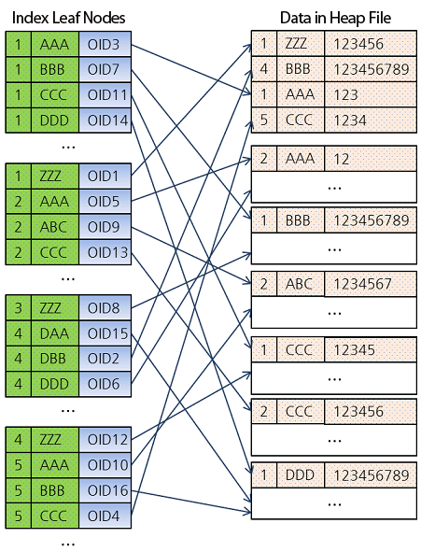
Composite Index
MyData
Col1 Col2 Col3
Col1 Col2
Co-index multiple columns
e.g. Phone book index (lastname, firstname)
Supports search on
First column
First column, second column
Not useful for search on
Second column
Second column, first column
Notes:
This shows a hash index, but any index can be used

Slide 45
Overheads vs Performance
Overheads:
Index requires disk/memory space
Index must be maintained
Performance
Much faster retrieval times
Can’t index everything!
MySQL automatically indexes primary key
Indexes used to enforce UNIQUE constraint

Slide 46
Choosing to Index
When to use
When to avoid
Frequently accessed foreign key
Particularly for joins
Performance outweighs overhead
Frequently accessed search attribute
Performance outweighs overhead
Frequently aggregated/sorted attribute
Performance outweighs overhead
Composite search term
Performance outweighs overhead
Small relations
Overhead outweighs performance
Volatile attributes
Overhead outweighs performance
Low selectivity
Attributes with limited values [M,F,O] (won’t reduce search space)
Notes:
Looking for performance to outweigh overhead of space and maintenance!

Slide 47
DDL: Indexes
CREATE INDEX
http://dev.mysql.com/doc/refman/5.6/en/create-index.html
CREATE INDEX emp_names_idx ON Employee(lastName, firstNames);
DROP INDEX
http://dev.mysql.com/doc/refman/5.6/en/drop-index.html
DROP INDEX emp_names_idx;
SHOW INDEX
http://dev.mysql.com/doc/refman/5.6/en/show-index.html
SHOW INDEX FROM Employee;

Slide 48
Index Access
Reduces disc accesses required
Indexes held in memory
Useful for other optimizations
π _{E.lastname,} _{E.firstname,} _{E.salary}
π _{E.lastname,} _{E.firstname,} _{E.salary}
⋈_{D.dNum = L.ldNum}
⋈_{D.dNum = L.ldNum}
⋈_{D.dNum = E.dNum}
π _{L.ldNum}
⋈_{D.dNum = E.dNum}
π _{L.ldNum}
π _{E.lastname,} _{E.firstname,} _{E.salary,} _{E.dNum}
σ_{L.loc =} _{‘Riccarton’}
π _{E.lastname,} _{E.firstname,} _{E.salary,} _{E.dNum}
σ_{L.loc =} _{‘Riccarton’}
π _{D.dNum}
Index_{D.dNum}
Department
Employee
Location
Employee
Location

Slide 49
JOIN Implementations
Many alternatives
Generate the same answer
Different runtime characteristics
Speed
Use of indexes
Use of resources: number of disk accesses
Join algorithms:
Nested Loops
Index nested loops
Hash join
Merge/sort join
https://en.wikipedia.org/wiki/Category:Join_algorithms

Slide 50
Nested Loops Join
Department
Employee
dNum | …
1 | …
2 | …
3 | …
… | …
ssn | dNum | …
122 | 1 | …
123 | 1 | …
124 | 2 | …
… | … | …
Result
dNum | … | ssn | …
1 | … | 122 | …
1 | … | 123 | …
1 | … | … | …
2 | … | 124 | …
2 | … | … | …
Notes:
Performance can be improved by exploiting blocks on disk

Slide 51
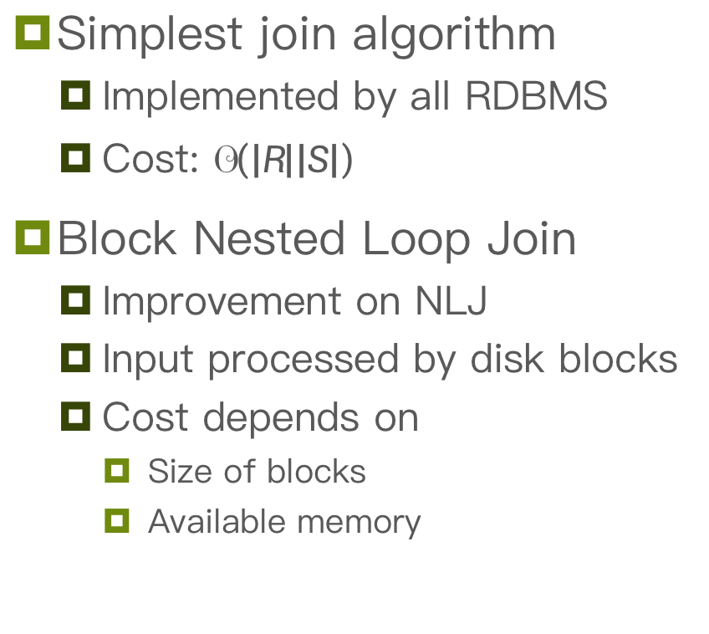
Nested Loops Join (NLJ)
Simplest join algorithm
Implemented by all RDBMS
Cost: $𝒪\left(\left|R\right|\left|S\right|\right)$
Block Nested Loop Join
Improvement on NLJ
Input processed by disk blocks
Cost depends on
Size of blocks
Available memory

Slide 52
Index Nested Loops
Department
Employee
dNum | …
1 | …
2 | …
3 | …
… | …
ssn | dNum | …
122 | 1 | …
123 | 1 | …
124 | 2 | …
… | … | …
Use index on Employee.dNum

Slide 53

Index Nested Loop Join
Enhancement of NLJ
Use index to seek values from inner relation
Cost: $𝒪\left(\left|R\right|\right)$

Slide 54
More Joins
Sort-Merge join
Sort both inputs
Merge
Hash join
Hash one of the inputs
Join same as index nested loops
https://logicalread.com/oracle-11g-sort-merge-joins-mc02

Slide 55
Join Optimisation
Switch join ordering for nested loops
Reduces number of scans
Choose Index NLJ
Exploits index
π _{E.lastname,} _{E.firstname,} _{E.salary}
π _{E.lastname,} _{E.firstname,} _{E.salary}
⋈_{D.dNum = L.ldNum}
⋈_{D.dNum = L.ldNum}
⋈_{D.dNum = E.dNum}
π _{L.ldNum}
Index NLJ_{E.dNum = D.dNum}
π _{L.ldNum}
π _{E.lastname,} _{E.firstname,} _{E.salary,} _{E.dNum}
σ_{L.loc =} _{‘Riccarton’}
π _{E.lastname,} _{E.firstname,} _{E.salary,} _{E.dNum}
Index_{D.dNum}
σ_{L.loc =} _{‘Riccarton’}
Index_{D.dNum}
Employee
Location
Employee
Location

Slide 56
Join ordering
Pipelining
Results not materialised
Data flows from one operator to the next
Implementations favour left-deep trees (a)

Slide 57
Join Ordering: which is more efficient?
A
π _{E.lastname,} _{E.firstname,} _{E.salary}
π _{E.lastname,} _{E.firstname,} _{E.salary}
B
NLJ_{D.dNum = L.ldNum}
NLJ_{D.dNum = L.ldNum}
Index NLJ_{E.dNum = D.dNum}
π _{L.ldNum}
π _{L.ldNum}
Index NLJ_{E.dNum = D.dNum}
π _{E.lastname,} _{E.firstname,} _{E.salary,} _{E.dNum}
Index_{D.dNum}
σ_{L.loc =} _{‘Riccarton’}
σ_{L.loc =} _{‘Riccarton’}
π _{E.lastname,} _{E.firstname,} _{E.salary,} _{E.dNum}
Index_{D.dNum}
Employee
Location
Location
Employee
Notes:
Socrative: Which is better?
Left: it is left-deep tree. Able to doing pipelining

Slide 58
Cost-based Optimisation
Estimate execution cost of each plan
Dominated by disk access cost
Join selection: different joins have different costs
Index access
Estimate selectivity of conditions
Based on data statistics
Statistics need to be fresh
Cost in maintaining stats
Choose plan with lowest cost for optimization goal
Database Statistics
Relation
Cardinality: number of rows
Number of disc blocks
Number of tuples per block
Attribute: calculate selectivity
Number of distinct values
Minimum value
Maximum value
Data distribution
Index
Number of levels
Number of leaf blocks

Slide 59
Query Plans in MySQL
For information

Slide 60
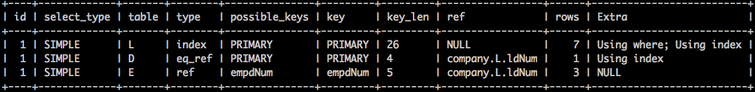
Explain Plan: SPJ query
EXPLAIN SELECT E.lastname, E.firstnames, E.salary FROM DBEmployee as E, DBDepartment as D, DBLocation as L WHERE E.empdNum = D.dNum AND D.dNum = L.ldNum AND L.loc = ‘Riccarton’;
Notes:
Key thing is the join order:
DBLocation 7
DBDepartment 1
DBEmployee 3

Slide 61
Explain Plan: Nested Subquery
EXPLAIN SELECT E.lastname, E.firstname, E.salary FROM Employee as E, Department as D WHERE E.empdNum = D.dNum AND D.dNum IN (SELECT ldnum FROM Location L WHERE L.loc = ‘Riccarton’);
Notes:
Key thing is the join order:
DBDepartment 8
DBEmployee 3
DBLocation 1

Slide 62
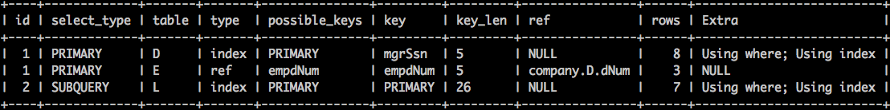
Explain Plan: Negated Subquery
EXPLAIN SELECT E.lastname, E.firstname, E.salary FROM Employee as E, Department as D WHERE E.empdNum = D.dNum AND D.dNum NOT IN (SELECT ldnum FROM Location L WHERE L.loc = ‘Riccarton’);
Notes:
Key thing is the join order:
DBDepartment 8: no selectivity in the outer query
DBEmployee 3
DBLocation 7

Slide 63
Summary

Slide 64
Summary: Query Processing
Note the use of the system catalog and database statistics to inform query planning.
Diagram from Connolly and Begg. Database Systems. Addison Wesley

Slide 65
Summary: Query Optimisation
Query processing: parse, optimise, execute
Optimisation:
Logical based on relational algebra
Push selection and projection down – reduces intermediary result sizes
Reorder joins so smallest tables considered first
Physical: choose join implementation and table access
Exploit indexes
Cost plans based on data statistics and selectivity estimates
Explain plan shows the DBMS choice
EXPLAIN SELECT …

Slide 66
Summary: Relational Algebra
Provides a mathematical formalism for querying
Selection σ_{A}: applies condition A to rows
Projection π_{a1,…,an}: returns columns a1,…,an
Cartesian product R×S: returns a table consisting of each row from R linked with each row from S
Join R⋈_{A}S: returns the combined rows of R and S joined on condition A
Operators are composable to form expressions
Equivalence rules: enable manipulation of algebra expressions

Slide 67
References
Connolly, T., & Begg, C. (2005). Database Systems: A Practical Approach to Design, Implementation, and Management (4th ed.). Addison Wesley. Chapters 4 & 21
Ward, P. (2008). Database Management Systems (2nd ed.). Middlesex University Press. Chapter 7

